Slide 1
Attention Mechanisms and Transformers
Concepts are ensembled from various online sources with a great acknowledgement to all those made them available online.

Slide 2
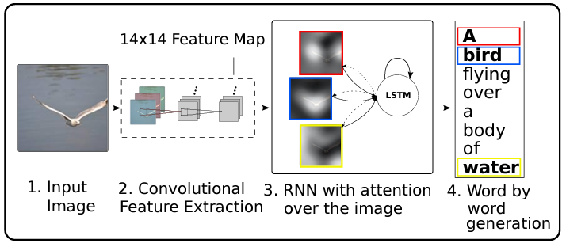
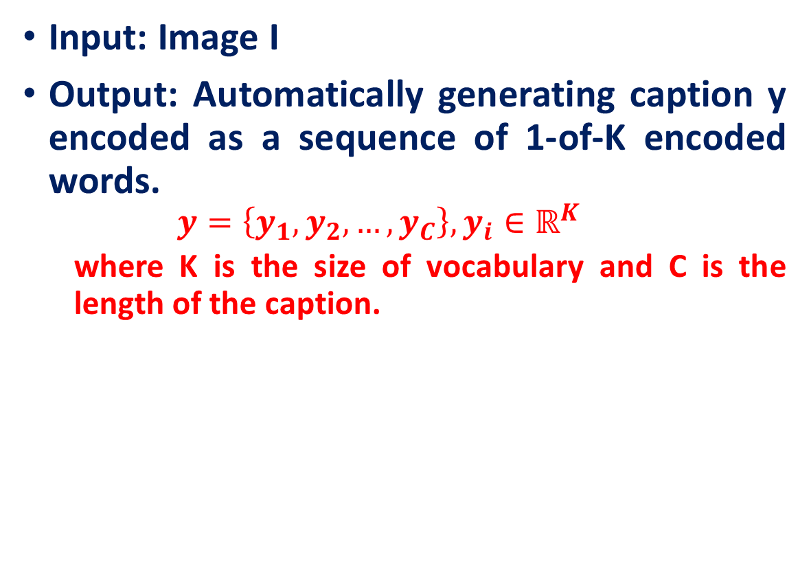
Image Captioning using spatial features
Input: Image I
Output: Automatically generating caption y encoded as a sequence of 1-of-K encoded words.
$$y=\left\{y_{1},y_{2},…,y_{C}\right\}, y_{i}∈ℝ^{K}$$
where K is the size of vocabulary and C is the length of the caption.
Xu, K., Ba, J. L., Kiros, R., Cho, K., Courville, A., Salakhutdinov, R., ... & Bengio, Y. “Show, attend and tell: neural image caption generation with visual attention”. ICML, 2015

Slide 3

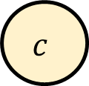
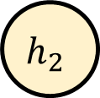
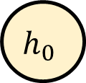
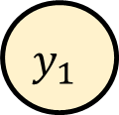


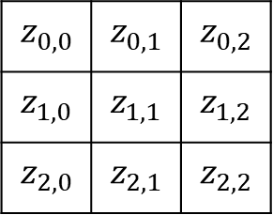
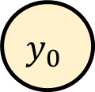
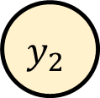
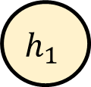
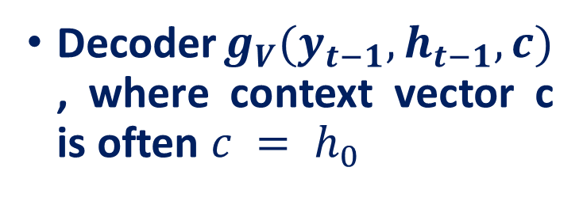
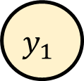
Image Captioning using spatial features
CNN is used as an encoder to extract feature vectors
Encoder: $h_{0}=f_{W}\left(z\right)$, where z is spatial CNN features and $f_{W}(⋅)$ is an MLP
Decoder$g_{V}(y_{t−1},h_{t−1},c)$ , where context vector c is often $c = h_{0}$
A
bird
$$y_{1}$$
$$y_{2}$$
$$z_{0,0}$$ | $$z_{0,1}$$ | $$z_{0,2}$$
$$z_{1,0}$$ | $$z_{1,1}$$ | $$z_{1,2}$$
$$z_{2,0}$$ | $$z_{2,1}$$ | $$z_{2,2}$$
Encoder (CNN)
$$h_{0}$$
$$h_{1}$$
$$h_{2}$$
MLP
$$H×W×D$$
Extract spatial features from a pretrained CNN
$$c$$
$$y_{0}$$
$$y_{1}$$
[START]
A
Xu, K., Ba, J. L., Kiros, R., Cho, K., Courville, A., Salakhutdinov, R., ... & Bengio, Y. “Show, attend and tell: neural image caption generation with visual attention”. ICML, 2015

Slide 4
Image Captioning using spatial features
Problem: Input is "bottlenecked" through c
Model needs to encode everything it wants to say within c
This is a problem if we want to generate really long descriptions? 100s of words long
A
bird
$$y_{1}$$
$$y_{2}$$
$$z_{0,0}$$ | $$z_{0,1}$$ | $$z_{0,2}$$
$$z_{1,0}$$ | $$z_{1,1}$$ | $$z_{1,2}$$
$$z_{2,0}$$ | $$z_{2,1}$$ | $$z_{2,2}$$
Encoder (CNN)
$$h_{0}$$
$$h_{1}$$
$$h_{2}$$
MLP
$$H×W×D$$
Extract spatial features from a pretrained CNN
$$c$$
$$y_{0}$$
$$y_{1}$$
[START]
A
Xu, K., Ba, J. L., Kiros, R., Cho, K., Courville, A., Salakhutdinov, R., ... & Bengio, Y. “Show, attend and tell: neural image caption generation with visual attention”. ICML, 2015

Slide 5
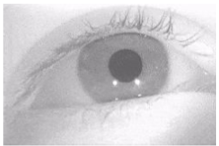
Image Captioning using spatial features
How as a human, we see the picture?
Attention Saccades in humans
A
bird
$$y_{1}$$
$$y_{2}$$
$$z_{0,0}$$ | $$z_{0,1}$$ | $$z_{0,2}$$
$$z_{1,0}$$ | $$z_{1,1}$$ | $$z_{1,2}$$
$$z_{2,0}$$ | $$z_{2,1}$$ | $$z_{2,2}$$
Encoder (CNN)
$$h_{0}$$
$$h_{1}$$
$$h_{2}$$
MLP
$$H×W×D$$
Extract spatial features from a pretrained CNN
$$c$$
$$y_{0}$$
$$y_{1}$$
[START]
A
A
Xu, K., Ba, J. L., Kiros, R., Cho, K., Courville, A., Salakhutdinov, R., ... & Bengio, Y. “Show, attend and tell: neural image caption generation with visual attention”. ICML, 2015

Slide 6
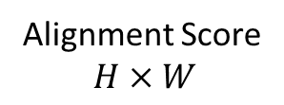
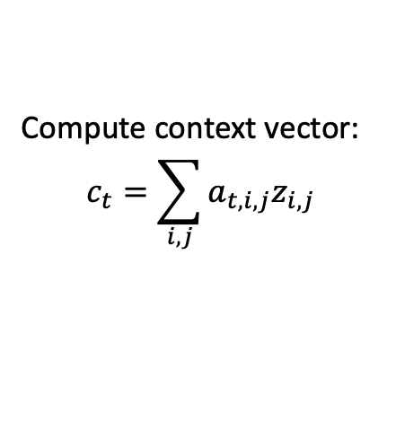
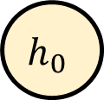
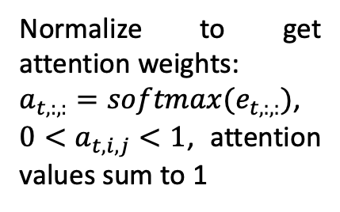
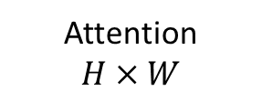
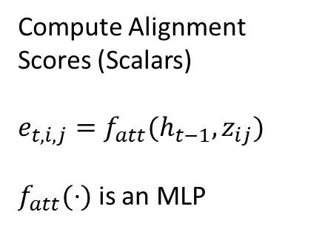
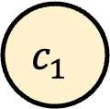
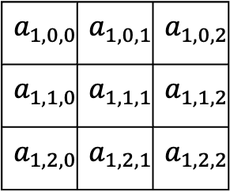
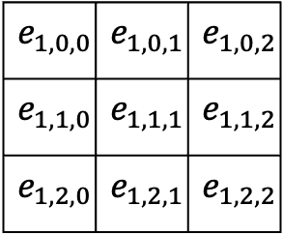
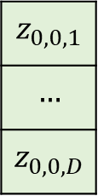

Image Caption Generation with Attention Mechanism
Alignment Score
$$H×W$$
Attention
$$H×W$$
Part of an Image
Compute Alignment Scores (Scalars)
$$e_{t,i,j}=f_{att}(h_{t−1},z_{ij})$$
$f_{att}(⋅)$ is an MLP
$$e_{1,0,0}$$ | $$e_{1,0,1}$$ | $$e_{1,0,2}$$
$$e_{1,1,0}$$ | $$e_{1,1,1}$$ | $$e_{1,1,2}$$
$$e_{1,2,0}$$ | $$e_{1,2,1}$$ | $$e_{1,2,2}$$
$$a_{1,0,0}$$ | $$a_{1,0,1}$$ | $$a_{1,0,2}$$
$$a_{1,1,0}$$ | $$a_{1,1,1}$$ | $$a_{1,1,2}$$
$$a_{1,2,0}$$ | $$a_{1,2,1}$$ | $$a_{1,2,2}$$
Normalize to get attention weights:
$a_{t,:,:}=softmax(e_{t,:,:})$,
$0<a_{t,i,j}<1$, attention values sum to 1
$$z_{0,0,1}$$
$$…$$
$$z_{0,0,D}$$
Compute context vector:
$$c_{t}=\sum_{i,j}{a_{t,i,j}z_{i,j}}$$
$$z_{0,0}$$ | $$z_{0,1}$$ | $$z_{0,2}$$
$$z_{1,0}$$ | $$z_{1,1}$$ | $$z_{1,2}$$
$$z_{2,0}$$ | $$z_{2,1}$$ | $$z_{2,2}$$
Encoder (CNN)
$$h_{0}$$
MLP
$$H×W×D$$
Extract spatial features from a pretrained CNN
$$⨂$$
$$c_{1}$$
Xu, K., Ba, J. L., Kiros, R., Cho, K., Courville, A., Salakhutdinov, R., ... & Bengio, Y. “Show, attend and tell: neural image caption generation with visual attention”. ICML, 2015

Slide 7
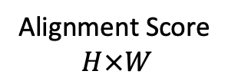
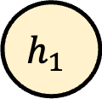
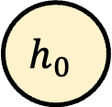

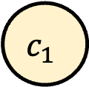
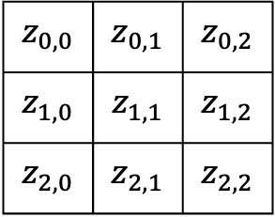

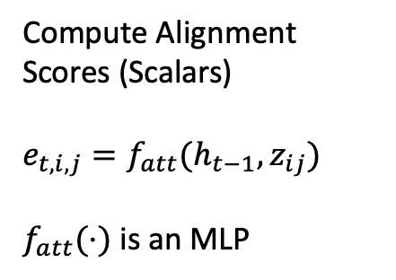
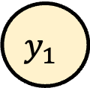
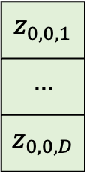
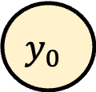
Image Caption Generation with Attention Mechanism
Alignment Score
$$H×W$$
Attention
$$H×W$$
Part of an Image
Compute Alignment Scores (Scalars)
$$e_{t,i,j}=f_{att}(h_{t−1},z_{ij})$$
$f_{att}(⋅)$ is an MLP
$$e_{1,0,0}$$ | $$e_{1,0,1}$$ | $$e_{1,0,2}$$
$$e_{1,1,0}$$ | $$e_{1,1,1}$$ | $$e_{1,1,2}$$
$$e_{1,2,0}$$ | $$e_{1,2,1}$$ | $$e_{1,2,2}$$
$$a_{1,0,0}$$ | $$a_{1,0,1}$$ | $$a_{1,0,2}$$
$$a_{1,1,0}$$ | $$a_{1,1,1}$$ | $$a_{1,1,2}$$
$$a_{1,2,0}$$ | $$a_{1,2,1}$$ | $$a_{1,2,2}$$
$$z_{0,0,1}$$
$$…$$
$$z_{0,0,D}$$
A
$$y_{1}$$
$$z_{0,0}$$ | $$z_{0,1}$$ | $$z_{0,2}$$
$$z_{1,0}$$ | $$z_{1,1}$$ | $$z_{1,2}$$
$$z_{2,0}$$ | $$z_{2,1}$$ | $$z_{2,2}$$
Encoder (CNN)
$$h_{0}$$
$$h_{1}$$
MLP
$$H×W×D$$
Extract spatial features from a pretrained CNN
$$⨂$$
$$c_{1}$$
$$y_{0}$$
[START]
Xu, K., Ba, J. L., Kiros, R., Cho, K., Courville, A., Salakhutdinov, R., ... & Bengio, Y. “Show, attend and tell: neural image caption generation with visual attention”. ICML, 2015

Slide 8
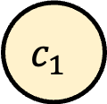
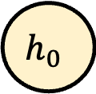
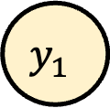
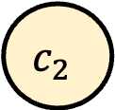
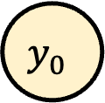
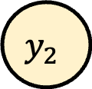
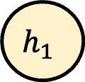
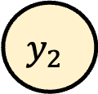
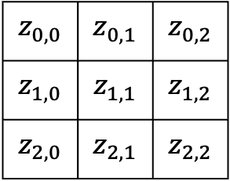
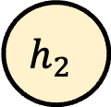
Image Caption Generation with Attention Mechanism
A
bird
$$y_{1}$$
$$y_{2}$$
$$z_{0,0}$$ | $$z_{0,1}$$ | $$z_{0,2}$$
$$z_{1,0}$$ | $$z_{1,1}$$ | $$z_{1,2}$$
$$z_{2,0}$$ | $$z_{2,1}$$ | $$z_{2,2}$$
Encoder (CNN)
$$h_{0}$$
$$h_{1}$$
$$h_{2}$$
MLP
Extract spatial features from a pretrained CNN
$$c_{1}$$
$$y_{0}$$
$$c_{2}$$
$$y_{2}$$
[START]
A
Xu, K., Ba, J. L., Kiros, R., Cho, K., Courville, A., Salakhutdinov, R., ... & Bengio, Y. “Show, attend and tell: neural image caption generation with visual attention”. ICML, 2015

Slide 9
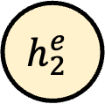
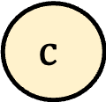
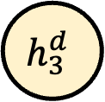


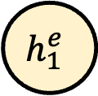
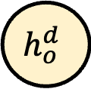
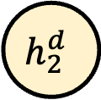
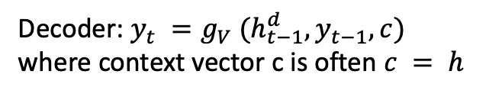















Language translation with Attention Mechanism
Input: Sequence $x = x_{1} , x_{2} ,…, x_{N}$
Output: Sequence $y = y_{1} , y_{2} ,…, y_{M}$
Decoder: $y_{t} =g_{V} (h_{t−1}^{d}, y_{t−1}, c)$
where context vector c is often $c = h$
Encoder: $h_{0}^{d} = f_{W} (h_{t}^{e})$
where $h_{t}^{e} = RNN(x_{t} , h_{t−1}^{e} )$
$f_{W} (⋅)$ is MLP
$$\text{मुझे}$$
$$\text{नहीं}$$
$$\text{पता}$$
$$\text{end}$$
$$h_{o}^{e}$$
$$h_{1}^{e}$$
$$h_{2}^{e}$$
$$h_{3}^{e}$$
$$h_{o}^{d}$$
$$h_{1}^{d}$$
$$h_{2}^{d}$$
$$h_{3}^{d}$$
$$h_{4}^{d}$$
$$I$$
$$do$$
$$not$$
$$know$$
$$c$$
start
$$\text{मुझे}$$
$$नहीं$$
$$\text{पता}$$

Slide 10













Language translation with Attention Mechanism
$$a_{1,0}$$
$$a_{1,1}$$
$$a_{1,2}$$
$$a_{1,3}$$
Compute alignments scores (scalars):
$$e_{t,i}=f_{att}\left(h_{t−1}^{d},h_{i}\right)$$
$f_{att}$ is an MLP
Normalize to get attention weights:
$a_{t,:}=softmax(e_{t,:})$,
$0<a_{t,i}<1$, attention values sum to 1
$$e_{1,0}$$
$$e_{1,1}$$
$$e_{1,2}$$
$$e_{1,3}$$
Compute context vector:
$$c_{t}=\sum_{i}{a_{t,i}h_{i}}$$
$$h_{o}^{e}$$
$$h_{1}^{e}$$
$$h_{2}^{e}$$
$$h_{3}^{e}$$
$$h_{o}^{d}$$
$$⨂$$
$$I$$
$$do$$
$$not$$
$$know$$
$$c_{1}$$

Slide 11
Language translation with Attention Mechanism
$$a_{1,0}$$
$$a_{1,1}$$
$$a_{1,2}$$
$$a_{1,3}$$
$$e_{1,0}$$
$$e_{1,1}$$
$$e_{1,2}$$
$$e_{1,3}$$
$$\text{मुझे}$$
$$h_{o}^{e}$$
$$h_{1}^{e}$$
$$h_{2}^{e}$$
$$h_{3}^{e}$$
$$h_{o}^{d}$$
$$h_{1}^{d}$$
$$⨂$$
$$I$$
$$do$$
$$not$$
$$know$$
$$c_{1}$$
start

Slide 12









Language translation with Attention Mechanism
$$a_{2,0}$$
$$a_{2,1}$$
$$a_{2,2}$$
$$a_{2,3}$$
$$e_{2,0}$$
$$e_{2,1}$$
$$e_{2,2}$$
$$e_{2,3}$$
$$\text{मुझे}$$
$$\text{नहीं}$$
$$h_{o}^{e}$$
$$h_{1}^{e}$$
$$h_{2}^{e}$$
$$h_{3}^{e}$$
$$h_{o}^{d}$$
$$h_{1}^{d}$$
$$h_{2}^{d}$$
$$⨂$$
$$I$$
$$do$$
$$not$$
$$know$$
$$c_{2}$$
start
$$\text{मुझे}$$

Slide 13









Language translation with Attention Mechanism
$$a_{3,0}$$
$$a_{3,1}$$
$$a_{3,2}$$
$$a_{3,3}$$
$$e_{3,0}$$
$$e_{3,1}$$
$$e_{3,2}$$
$$e_{3,3}$$
$$\text{मुझे}$$
$$\text{नहीं}$$
$$\text{पता}$$
$$h_{o}^{e}$$
$$h_{1}^{e}$$
$$h_{2}^{e}$$
$$h_{3}^{e}$$
$$h_{o}^{d}$$
$$h_{1}^{d}$$
$$h_{2}^{d}$$
$$h_{3}^{d}$$
$$⨂$$
$$I$$
$$do$$
$$not$$
$$know$$
$$c_{3}$$
start
$$\text{मुझे}$$
$$नहीं$$

Slide 14









Language translation with Attention Mechanism
$$a_{4,0}$$
$$a_{4,1}$$
$$a_{4,2}$$
$$a_{4,3}$$
$$e_{4,0}$$
$$e_{4,1}$$
$$e_{4,2}$$
$$e_{4,3}$$
$$\text{मुझे}$$
$$\text{नहीं}$$
$$\text{पता}$$
$$\text{end}$$
$$h_{o}^{e}$$
$$h_{1}^{e}$$
$$h_{2}^{e}$$
$$h_{3}^{e}$$
$$h_{o}^{d}$$
$$h_{1}^{d}$$
$$h_{2}^{d}$$
$$h_{3}^{d}$$
$$h_{4}^{d}$$
$$⨂$$
$$I$$
$$do$$
$$not$$
$$know$$
$$c_{4}$$
start
$$\text{मुझे}$$
$$नहीं$$
$$\text{पता}$$

Slide 15
Self-Attention Mechanism & Transformers

Slide 16

Transformers
Transformer introduced a new modeling paradigm:
In contrast to previous models where processing within encoder and decoder was done with recurrence or convolutions, Transformer operates using only attention.

Slide 17
Transformers: Getting rid of the sequential parts
No recurrence, no convolution
Transformers rely on the self-attention mechanism, processing the whole sequence all at once (no sequential processing like in RNNs)
Transformers also have encoder & decoder parts. But instead of using LSTMs, they use stacked attention layers

Slide 18

Advantage Over RNNs/CNN based Encoder/Decoder
When encoding a sentence, RNNs won't understand what bank means until they read the whole sentence, and this can take a while for long sequences.
In contrast, in Transformer's encoder tokens interact with each other all at once.
Advantage?
Parallelism

Slide 19
Advantage Over RNNs/CNN based Encoder/Decoder
Encoder
In each encoder layer, tokens look at each other, exchange information and try to understand each other better in the context of the whole sentence.
This happens in several layers
Decoder
In each decoder layer, tokens of the prefix also interact with each other via a self-attention mechanism, but additionally, they look at the encoder states

Slide 20

Transformer Illustration
The animation is from the Google AI blog post.

Slide 21

Self-Attention Mechanism-- Very Basic Form
Self-attention: relating different positions within a single sequence
Main procedure:
Derive attention weights: similarity between current input and all other inputs
Normalize weights via softmax
Compute attention value from normalized weights and corresponding inputs

Slide 22

Self-Attention Mechanism-- Very Basic Form

Slide 23


Self-Attention Mechanism- Very Basic Form
Dot product-based weights are large when $x_{i}$ and $x_{j}$ are similar. But we may want a more flexible approach.
Consider the sentence:
"The cat that the dog chased is hiding under the table."
In this sentence:
"cat" and "chased" need to interact because "the dog chased the cat," establishing a subject-object relationship.
However, "cat" and "chased" may not have similar vector representations, as one is a noun and the other is a verb. Using just the dot product (similarity-based) approach might fail to capture this dependency.
Similarly, "cat" and "hiding" should interact, as the sentence indicates that "the cat is hiding."
Learn attention weights $w_{ij}$ that depend on $x_{i}$ and $x_{j}$ in a manner that works best for the task

Slide 24

Self-attention with queries, keys, values
Let’s add learnable parameters (three weight matrices $W$ that allow us turn any input vector $x_{i}$ into three versions
Query vector: $q_{i}=x_{i}W_{q}$
Like search request
Think of this as representing the "focus" or "question" each word is asking about the other words in the sentence.
Key vector: $k_{i}=x_{i}W_{k}$
Like book titles/tags in the catalog
Represents the "descriptor" or characteristics of each word, which helps the model decide if that word is relevant to a given query.
Value vector: $v_{i}=x_{i}W_{v}$
Like the actual book content
Contains the actual content of the word that the model will pull from if the query and key are relevant.

Slide 25

Self-attention with queries, keys, values
Input Sentence: “The cat that the dog chased is hiding under the table."
Let’s say the model is processing the word “cat” and wants to understand the context in which it appears.
Query vector of “cat” (𝒒₁): This vector seeks information about "what is happening to the cat." It's the focus or context the model wants to understand about “cat.”
Key (𝒌ᵢ): For example, “dog” and “chased” have keys that relate to “cat” because they describe the action and the subject involved with it.
Value vector ($v_{i})$: For example, “dog” and “chased” contains the actual content of the word that the model will pull from if the query and key are relevant.

Slide 26




Attention: Recall
c
Outputs:
context vector: c (shape: D)
mul + add
$$a_{1,0,0}$$ | $$a_{1,0,1}$$ | $$a_{1,0,2}$$
$$a_{1,1,0}$$ | $$a_{1,1,1}$$ | $$a_{1,1,2}$$
$$a_{1,2,0}$$ | $$a_{1,2,1}$$ | $$a_{1,2,2}$$
Operations:
Alignment: $e_{i,j} = f_{att} (h, z_{i,j} )$
Attention: $a = softmax(e)$
Output: $c=\sum_{i,j}{a_{i,j}z_{i,j}}$
Attention
softmax
$$z_{0,0}$$ | $$z_{0,1}$$ | $$z_{0,2}$$
$$z_{1,0}$$ | $$z_{1,1}$$ | $$z_{1,2}$$
$$z_{2,0}$$ | $$z_{2,1}$$ | $$z_{2,2}$$
$$e_{1,0,0}$$ | $$e_{1,0,1}$$ | $$e_{1,0,2}$$
$$e_{1,1,0}$$ | $$e_{1,1,1}$$ | $$e_{1,1,2}$$
$$e_{1,2,0}$$ | $$e_{1,2,1}$$ | $$e_{1,2,2}$$
Features
Alignment
Inputs:
Features: z (shape: H x W x D)
Query: h (shape: D)
h

Slide 27















General attention layer
c
Outputs:
context vector: c (shape: D)
mul + add
$$a_{1}$$
Operations:
Alignment: $e_{i}= f_{att} (h, x_{i} )$
Attention: $a = softmax(e)$
Output: $c=\sum_{i}{a_{i}x_{i}}$
$$a_{2}$$
Attention
$$e_{1}$$ | $$e_{2}$$ |  |  |  | $$e_{N}$$
$$⋮$$
$$a_{T}$$
softmax
$$x_{1}$$
$$e_{1}$$
$$x_{2}$$
$$e_{2}$$
Alignment
Input Vectors
$$⋮$$
$$⋮$$
Inputs:
Input Vectors: $x$’s (shape: D$)$
Query: h (shape: D)
Attention operation is permutation invariant.
Doesn't care about ordering of the features-Stretch H x W = N into N vectors
$$x_{T}$$
$$e_{T}$$
h

Slide 28


General attention layer
c
Outputs:
context vector: c (shape: D)
mul + add
$$a_{1}$$
Operations:
Alignment: $e_{i}=h.x_{i}$
Attention: $a = softmax(e)$
Output: $c=\sum_{i}{a_{i}x_{i}}$
$$a_{2}$$
Attention
$$e_{1}$$ | $$e_{2}$$ |  |  |  | $$e_{N}$$
$$⋮$$
Change $f_{att} (⋅)$to a simple dot product
$$a_{T}$$
softmax
$$x_{1}$$
$$e_{1}$$
$$x_{2}$$
$$e_{2}$$
Alignment
Input Vectors
$$⋮$$
$$⋮$$
Inputs:
Input Vectors: $x$’s (shape: D$)$
Query: h (shape: D)
$$x_{T}$$
$$e_{T}$$
h

Slide 29











General attention layer
c
Outputs:
context vector: c (shape: D)
mul + add
$$a_{1}$$
Operations:
Alignment: $e_{i}=h.x_{i}/\sqrt{D}$
Attention: $a = softmax(e)$
Output: $c=\sum_{i}{a_{i}x_{i}}$
$$a_{2}$$
Attention
$$e_{1}$$ | $$e_{2}$$ |  |  |  | $$e_{N}$$
$$⋮$$
Change $f_{att} (⋅)$to a scaled simple dot product
Larger dimensions means more terms in the dot product sum.
So, the variance of the logits is higher. Large magnitude vectors will produce much higher logits.
Ultimately, these large magnitude vectors will cause softmax to peak and assign very little weight to all others
Divide by √D to reduce effect of large magnitude vectors
$$a_{T}$$
softmax
$$x_{1}$$
$$e_{1}$$
$$x_{2}$$
$$e_{2}$$
Alignment
Input Vectors
$$⋮$$
$$⋮$$
Inputs:
Input Vectors: $x$’s (shape: D$)$
Query: h (shape: D)
$$x_{T}$$
$$e_{T}$$
h

Slide 30




























General attention layer
$$y_{1}$$
$$y_{T}$$
Outputs:
context vector: c (shape: D)
mul + add
$$a_{1,1}$$
$$a_{1,T}$$
Operations:
Alignment: $e_{i,j}=q_{j}.x_{i}/\sqrt{D}$
Attention: $a = softmax(e)$
Output: $y_{j}=\sum_{i,j}{a_{i,j}x_{i}}$
$$a_{2,1}$$
$$a_{2,T}$$
$$e_{1,j}$$ | $$e_{2,j}$$ |  |  |  | $$e_{N,j}$$
Attention
$$⋮$$
$$⋮$$
$$a_{T,1}$$
$$a_{T,T}$$
Multiple query vectors
each query creates a new output context vector
softmax
$$x_{1}$$
$$e_{1,1}$$
$$e_{1,T}$$
$$x_{2}$$
$$e_{2,1}$$
$$e_{2,T}$$
Input Vectors
Alignment
$$⋮$$
$$⋮$$
$$⋮$$
Inputs:
Input Vectors: $x$’s (shape: D$)$
Queries: $q$’s (shape: D)
$$x_{T}$$
$$e_{T,1}$$
$$e_{T,T}$$
Multiple query vectors
$$q_{1}$$
$$q_{T}$$
$$⋮$$

Slide 31

General attention layer
$$y_{1}$$
$$y_{T}$$
Outputs:
context vector: c (shape: D)
mul + add
$$a_{1,1}$$
$$a_{1,T}$$
Operations:
Alignment: $e_{i,j}=q_{j}.x_{i}/\sqrt{D}$
Attention: $a = softmax(e)$
Output: $y_{j}=\sum_{i,j}{a_{i,j}x_{i}}$
$$a_{2,1}$$
$$a_{2,T}$$
$$e_{1,j}$$ | $$e_{2,j}$$ |  |  |  | $$e_{N,j}$$
Attention
$$⋮$$
$$⋮$$
$$a_{T,1}$$
$$a_{T,T}$$
Notice that the input vectors are used for both the alignment as well as the attention calculations.
We can add more expressivity to the layer by adding a different FC layer before each of the two steps.
softmax
$$x_{1}$$
$$e_{1,1}$$
$$e_{1,T}$$
$$x_{2}$$
$$e_{2,1}$$
$$e_{2,T}$$
Input Vectors
Alignment
$$⋮$$
$$⋮$$
$$⋮$$
Inputs:
Input Vectors: $x$’s (shape: D$)$
Queries: $q$’s (shape: D)
$$x_{T}$$
$$e_{T,1}$$
$$e_{T,T}$$
$$q_{1}$$
$$q_{T}$$
$$⋮$$

Slide 32










General attention layer
$$y_{1}$$
$$y_{T}$$
Outputs:
context vector: c (shape: D)
mul + add
$$v_{1}$$
$$a_{1,1}$$
$$a_{1,T}$$
Operations:
Key vectors: $k_{i} =x_{i}W_{k}$
Value vectors: $v_{i} = x_{i}W_{v}$
Alignment: $e_{i,j}=q_{j}.k_{i}/\sqrt{D}$
Attention: $a = softmax(e)$
Output: $y_{j}=\sum_{i,j}{a_{i,j}v_{i}}$
$$v_{2}$$
$$a_{2,1}$$
$$a_{2,T}$$
Notice that the input vectors are used for both the alignment as well as the attention calculations.
We can add more expressivity to the layer by adding a different FC layer before each of the two steps.
Attention
$$⋮$$
$$⋮$$
$$⋮$$
$$v_{T}$$
$$a_{T,1}$$
$$a_{T,T}$$
softmax
$$x_{1}$$
$$k_{1}$$
$$e_{1,1}$$
$$e_{1,T}$$
$$x_{2}$$
$$k_{2}$$
$$e_{2,1}$$
$$e_{2,T}$$
Input Vectors
Alignment
$$⋮$$
$$⋮$$
$$⋮$$
$$⋮$$
Inputs:
Input Vectors: $x$’s (shape: D$)$
Queries: $q$’s (shape: D)
The input and output dimensions can now change depending on the key and value FC layers
$$x_{T}$$
$$k_{T}$$
$$e_{T,1}$$
$$e_{T,T}$$
$$q_{1}$$
$$q_{T}$$
$$⋮$$

Slide 33

General attention layer
$$y_{1}$$
$$y_{T}$$
Outputs:
context vector: c (shape: D)
mul + add
$$v_{1}$$
$$a_{1,1}$$
$$a_{1,T}$$
Operations:
Key vectors: $k_{i} =x_{i}W_{k}$
Value vectors: $v_{i} = x_{i}W_{v}$
Alignment: $e_{i,j}=q_{j}.k_{i}/\sqrt{D}$
Attention: $a = softmax(e)$
Output: $y_{j}=\sum_{i,j}{a_{i,j}v_{i}}$
$$v_{2}$$
$$a_{2,1}$$
$$a_{2,T}$$
Attention
$$⋮$$
$$⋮$$
$$⋮$$
$$v_{T}$$
$$a_{T,1}$$
$$a_{T,T}$$
softmax
$$x_{1}$$
$$k_{1}$$
$$e_{1,1}$$
$$e_{1,T}$$
$$x_{2}$$
$$k_{2}$$
$$e_{2,1}$$
$$e_{2,T}$$
Input Vectors
Alignment
$$⋮$$
$$⋮$$
$$⋮$$
$$⋮$$
Inputs:
Input Vectors: $x$’s (shape: D$)$
Queries: $q$’s (shape: D)
$$x_{T}$$
$$k_{T}$$
$$e_{T,1}$$
$$e_{T,T}$$
$$q_{1}$$
$$q_{T}$$
$$⋮$$

Slide 34


Self attention layer
$$y_{1}$$
$$y_{T}$$
Outputs:
context vector: c (shape: D)
mul + add
$$v_{1}$$
$$a_{1,1}$$
$$a_{1,T}$$
Operations:
Key vectors: $k_{i} =x_{i}W_{k}$
Value vectors: $v_{i} = x_{i}W_{v}$
Query: $q_{j}=x_{j}W_{q}$
Alignment: $e_{i,j}=q_{j}.k_{i}/\sqrt{D}$
Attention: $a = softmax(e)$
Output: $y_{j}=\sum_{i,j}{a_{ij}v_{i}}$
$$v_{2}$$
$$a_{2,1}$$
$$a_{2,T}$$
Attention
We can calculate the query vectors from the input vectors, therefore, defining a "self-attention" layer.
$$⋮$$
$$⋮$$
$$⋮$$
$$v_{T}$$
$$a_{T,1}$$
$$a_{T,T}$$
softmax
$$x_{1}$$
$$k_{1}$$
$$e_{1,1}$$
$$e_{1,T}$$
$$x_{2}$$
$$k_{2}$$
$$e_{2,1}$$
$$e_{2,T}$$
Input Vectors
Alignment
$$⋮$$
$$⋮$$
$$⋮$$
$$⋮$$
Inputs:
Input Vectors: $x$’s (shape: D$)$
$$x_{T}$$
$$k_{T}$$
$$e_{T,1}$$
$$e_{T,T}$$
$$q_{1}$$
$$q_{T}$$
$$⋮$$

Slide 35
Self attention layer - attends over sets of inputs
$$y_{1}$$
$$y_{T}$$
Outputs:
context vector: c (shape: D)
mul + add
$$v_{1}$$
$$a_{1,1}$$
$$a_{1,T}$$
Operations:
Key vectors: $k_{i} =x_{i}W_{k}$
Value vectors: $v_{i} = x_{i}W_{v}$
Query: $q_{j}=x_{j}W_{q}$
Alignment: $e_{i,j}=q_{j}.k_{i}/\sqrt{D}$
Attention: $a = softmax(e)$
Output: $y_{j}=\sum_{i,j}{a_{ij}v_{i}}$
$$v_{2}$$
$$a_{2,1}$$
$$a_{2,T}$$
Attention
$$⋮$$
$$⋮$$
$$⋮$$
$$v_{T}$$
$$a_{T,1}$$
$$a_{T,T}$$
softmax
$$x_{1}$$
$$k_{1}$$
$$e_{1,1}$$
$$e_{1,T}$$
$$x_{2}$$
$$k_{2}$$
$$e_{2,1}$$
$$e_{2,T}$$
Input Vectors
Alignment
$$⋮$$
$$⋮$$
$$⋮$$
$$⋮$$
Inputs:
Input Vectors: $x$’s (shape: D$)$
$$x_{T}$$
$$k_{T}$$
$$e_{T,1}$$
$$e_{T,T}$$
$$q_{1}$$
$$q_{T}$$
$$⋮$$

Slide 36

Self attention layer - attends over sets of inputs
$$y_{1}$$
$$y_{T}$$
Outputs:
context vector: c (shape: D)
mul + add
$$v_{1}$$
$$a_{1,1}$$
$$a_{1,T}$$
Permutation invariant
Problem: how can we encode ordered sequences like language or spatially ordered image features?
Operations:
Key vectors: $k_{i} =x_{i}W_{k}$
Value vectors: $v_{i} = x_{i}W_{v}$
Query: $q_{j}=x_{j}W_{q}$
Alignment: $e_{i,j}=q_{j}.k_{i}/\sqrt{D}$
Attention: $a = softmax(e)$
Output: $y_{j}=\sum_{i,j}{a_{ij}v_{i}}$
$$v_{2}$$
$$a_{2,1}$$
$$a_{2,T}$$
Attention
$$⋮$$
$$⋮$$
$$⋮$$
$$v_{T}$$
$$a_{T,1}$$
$$a_{T,T}$$
softmax
$$x_{1}$$
$$k_{1}$$
$$e_{1,1}$$
$$e_{1,T}$$
$$x_{2}$$
$$k_{2}$$
$$e_{2,1}$$
$$e_{2,T}$$
Input Vectors
Alignment
$$⋮$$
$$⋮$$
$$⋮$$
$$⋮$$
Inputs:
Input Vectors: $x$’s (shape: D$)$
$$x_{T}$$
$$k_{T}$$
$$e_{T,1}$$
$$e_{T,T}$$
$$q_{1}$$
$$q_{T}$$
$$⋮$$

Slide 38
Position Encodings
self-attention layers are permutation-equivariant.
This means that sentences of the form: “Jack gave water to Jill” and “Jill gave water to Jack” will learn the exact same features.
How does this model capture sequence order?

Slide 39

Position Encodings
How does this model capture sequence order?
Use vectors that are already position-dependent as inputs, or
Change the self-attention operation itself.
The Transformer adds the positional encoding (PE) to the input embeddings before sending the embeddings into the encoder layers.
The positional encoding uses sine and cosine functions of different frequencies.
https://web.stanford.edu/class/cs224n/readings/cs224n-self-attention-transformers-2023_draft.pdf

Slide 40

Position Encodings
The Transformer adds the positional encoding (PE) to the input embeddings before sending the embeddings into the encoder layers.
The positional encoding uses sine and cosine functions of different frequencies.
Let pos denote the index of the token in input sentence and I represent the ith dimension out of d
$PE_{(pos,2i)}=sin\left(\frac{pos}{10000^{\frac{2i}{d}}}\right)$ and $PE_{(pos,2i+1)}=cos\left(\frac{pos}{10000^{\frac{2i}{d}}}\right)$, $for i ∈ \{0,1,…,d/2 − 1\}$

Slide 41

Position Encodings
Sinusoid function properties
Unique Encoding at Each Position
Capturing Relative Position Information
Fixed, like table lookup

Slide 42

Multi-head self attention layer
Multiple self-attention heads in parallel
Problem with Single Attention: A single attention head struggles to capture both short-range and long-range dependencies in sequences simultaneously.
Multi-Head Attention Solution: Multi-head attention splits the attention mechanism into multiple heads, each focusing on different aspects of relationships within the sequence.

Slide 43

Masked self-attention layer
Prevent vectors from looking at future vectors.
Manually set alignment scores to -infinity

Slide 44

Transformer Architecture
Non-Recurrent Encoder-Decoder architecture
No hidden states
Context information captured via attention and positional encodings
Consists of stacks of layers with various sublayers

Slide 45
The Transformer encoder block
A stack of N identical layers
All layers and sublayers are 512-dimensional
Each layer consists of two sublayers
one multi-head self attention layer
one position-wise feed forward layer
Each sublayer is followed by an “Add & Norm” layer:
a residual connection x + Sublayer(x)
(the input is added to the output of the sublayer)
followed by a normalization step
(using the mean and standard deviation of its activations)
LayerNorm(x + Sublayer(x))

Slide 46
The Transformer encoder block
Residual connection x + Sublayer(x)
Preventing Vanishing Gradient Problem
Residual connections mitigate this by allowing gradients to flow directly through the network via skip connections. This direct path makes it easier to update weights in earlier layers during training.
Preserving Original Information
Helps it preserve essential details while adding new information from the transformations.
Improving Training Stability
Help stabilize training by preventing drastic changes in the data representation from one layer to the next.

Slide 47
The Transformer encoder block
feed forward layer
Adds non-linearity to capture complex token-wise patterns.
Separate sequence-related learning (attention) from token-wise transformation,

Slide 48
The Transformer Decoder block
A stack of N identical layers
All layers and sublayers are 512-dimensional
Each layer consists of three sublayers
one masked multi-head self attention layer over decoder output
masked, i.e. ignoring future tokens
one multi-headed attention layer
over encoder output
one position-wise feed forward layer

Slide 49


Slide 50
References
Lecture 11: Attention and Transformers, Fei-Fei Li, Ranjay Krishna, Danfei Xu
Lecture 19: RNNs and Transformers for Sequence-to-Sequence Modeling, Sebastian Raschka
https://courses.grainger.illinois.edu/cs447/sp2023/Slides/Lecture15.pdf
https://lena-voita.github.io/nlp_course/seq2seq_and_attention.html

